Slide 1
Virus resuspension for risk modeling
06.10.2021

Slide 2
Resuspension model
Want to find: Indoor air concentration C(t)
What do we need? (Can add anything that is missed)
Floor and house parameters:
Floor dust loading (vary floor type)
Floor viral load (or viral load per quantity dust)
Size distribution of floor dust
Size distribution of virus associated dust (how are virus distributed across floor dust size bins?)
Room dimensions: Volume
Room dimensions: Floor surface area
Resuspension area
Vacuuming area, rate and efficiency
Air filter efficiency (if including), Air change rate, penetration factor, Outdoor air concentration (C_{out}) (if including)
B. Other parameters:
10. Particle deposition rate (or velocity) (varies with diameter, constant with time)
11. Resuspension rate (varies with diameter, time, others not included here)
12. Walking speed of person (will change resuspension rate)
13. Number of people walking
14. Breathing rate (?) (unsure if needed here or in exposure later)
15. Virus inactivation rate (varies with time and type of surface/dust)
16. Mask efficiency, type

Slide 3
Resuspension model
What we have: Model assumptions
Model ignores outdoor air concentration (assume no virus/virus associated dust in outdoor air)
Model does not yet include mask, different flooring types, breathing rate (?), Air filter efficiency (if including), Air change rate, penetration factor, Outdoor air concentration (C_{out}) (if including), vacuum parameters.
We don’t yet know how virus are distributed across floor dust size bins (from A.4.) until we sieve.

Slide 4
Resuspension model
What we have: Parameters
# | Parameter | Description
1 | C(t) | Indoor air concentration of ‘virus associated dust’
2 | t | Time
3 | a | Air change rate
4 | p | Penetration factor
5 | C_{out} | Outdoor air concentration of ‘virus associated dust’
6 | r | Resuspension rate (particle size and time dependent)
7 | N | Number of occupants
8 | A_{r} | Resuspension area
9 | L(t) | Floor concentration of ‘virus associated dust’ (size dependent)
10 | V | Volume of room
11 | k_{dep} | Deposition rate
12 | k_{surf} | Virus inactivation rate (surface dependent)

Slide 5

Resuspension model
# | Parameter | Description
1 | C(t) | Indoor air concentration of ‘virus associated dust’
2 | t | Time
3 | a | Air change rate
4 | p | Penetration factor
5 | C_{out} | Outdoor air concentration of ‘virus associated dust’
6 | r | Resuspension rate (particle size and time dependent)
7 | N | Number of occupants
8 | A_{r} | Resuspension area
9 | L(t) | Floor concentration of ‘virus associated dust’ (size dependent)
10 | V | Volume of room
11 | k_{dep} | Deposition rate
12 | k_{surf} | Virus inactivation rate (surface dependent)
What we have: Equations
Indoor air concentration C(t)
$\frac{dC(t)}{dt}=apC_{out}+\frac{r\left(t,d_{p}\right){NA}_{r}L(t)}{V}−\left(a+k_{dep}\right)VC(t)$
$C\left(t\right)=\frac{rA_{r}L\left(t\right)}{V\left(a+k_{dep}\right)}\left(1−e^{−\left(a+k_{dep}\right)t}\right)+C\left(0\right)e^{−\left(a+k_{dep}\right)t}$
$C\left(t\right)=\frac{rA_{r}L\left(t\right)}{V\left(a+k_{dep}\right)}\left(1−e^{−\left(a+k_{dep}\right)t}\right)+C(0)e^{−\left(a+k_{dep}\right)t}$
All times in h, lengths in m, air concentration in µg/m³, surface concentration in µg/m².
To simplify, C_{out} = 0, N=1; Eqn I. becomes
Solving Eqn II. analytically,
If there are other loss or ‘k like’, we just add them along with (a+k_{dep}) term.

Slide 6
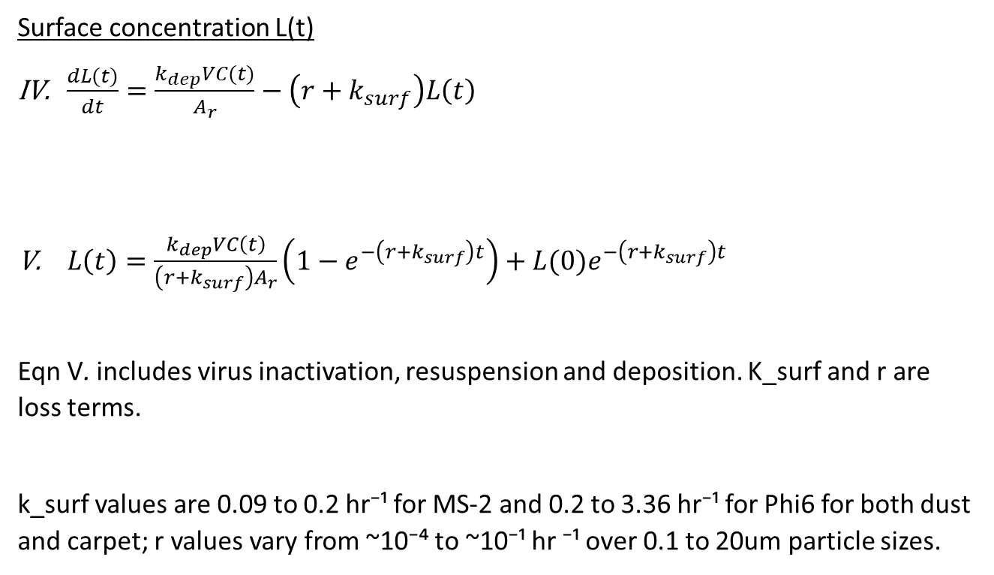
Resuspension model
# | Parameter | Description
1 | C(t) | Indoor air concentration of ‘virus associated dust’
2 | t | Time
3 | a | Air change rate
4 | p | Penetration factor
5 | C_{out} | Outdoor air concentration of ‘virus associated dust’
6 | r | Resuspension rate (particle size and time dependent)
7 | N | Number of occupants
8 | A_{r} | Resuspension area
9 | L(t) | Floor concentration of ‘virus associated dust’ (size dependent)
10 | V | Volume of room
11 | k_{dep} | Deposition rate
12 | k_{surf} | Virus inactivation rate (surface dependent)
What we have: Equations
Surface concentration L(t)
$\frac{dL(t)}{dt}=\frac{k_{dep}VC(t)}{A_{r}}−\left(r+k_{surf}\right)L\left(t\right)$
$L\left(t\right)=\frac{k_{dep}VC\left(t\right)}{\left(r+k_{surf}\right)A_{r}}\left(1−e^{−\left(r+k_{surf}\right)t}\right)+L(0)e^{−\left(r+k_{surf}\right)t}$
Eqn V. includes virus inactivation, resuspension and deposition. K_surf and r are loss terms.
k_surf values are 0.09 to 0.2 hr⁻¹ for MS-2 and 0.2 to 3.36 hr⁻¹ for Phi6 for both dust and carpet; r values vary from ~10⁻⁴ to ~10⁻¹ hr ⁻¹ over 0.1 to 20um particle sizes.
Solving Eqn IV. analytically we get,
Nastasi, Nicholas, et al. "Viability of MS2 and Phi6 Bacteriophages on Carpet and Dust." bioRxiv (2021).

Slide 7
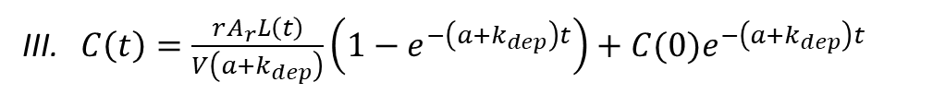
Resuspension model
# | Parameter | Description
1 | C(t) | Indoor air concentration of ‘virus associated dust’
2 | t | Time
3 | a | Air change rate
4 | p | Penetration factor
5 | C_{out} | Outdoor air concentration of ‘virus associated dust’
6 | r | Resuspension rate (particle size and time dependent)
7 | N | Number of occupants
8 | A_{r} | Resuspension area
9 | L(t) | Floor concentration of ‘virus associated dust’ (size dependent)
10 | V | Volume of room
11 | k_{dep} | Deposition rate
12 | k_{surf} | Virus inactivation rate (surface dependent)
What we have: Equations
We only need to solve III. and V. simultaneously
III. $C\left(t\right)=\frac{rA_{r}L\left(t\right)}{V\left(a+k_{dep}\right)}\left(1−e^{−\left(a+k_{dep}\right)t}\right)+C(0)e^{−\left(a+k_{dep}\right)t}$
V. $L\left(t\right)=\frac{k_{dep}VC\left(t\right)}{\left(r+k_{surf}\right)A_{r}}\left(1−e^{−\left(r+k_{surf}\right)t}\right)+L(0)e^{−\left(r+k_{surf}\right)t}$
**I calculated analytical solutions which others have done also, as a check for MATLAB’s ode45. Some have also used forward difference model to solve this.

Slide 8
Resuspension model
However, resuspension rates seem to vary with other parameters.
Variation of resuspension rate with diameter: larger particles resuspend more; it is probably helpful to have something that supports this.
Variation of resuspension rate with time: Resuspension rate reduced with time since quantity of ‘resuspendable’ particles reduce and probably also damping effect during walking. No clear relationship between resuspension rate with time is known but some have tried coming up with models.

Slide 9
Resuspension model
https://nvlpubs.nist.gov/nistpubs/TechnicalNotes/NIST.TN.1841.pdf
Variation of resuspension rate with diameter
I made a table of resuspension rate ranges for four average diameters from the plot (data from https://nvlpubs.nist.gov/nistpubs/TechnicalNotes/NIST.TN.1841.pdf)
Variation of resuspension rate with diameter for Silica, ATD and house dust since they were comparable values.
Average Diameter (um) | Resuspension rate (hr¯¹) | Average resuspension rate (hr¯¹)
7.5 | 0.013 – 0.045 | 0.029
3.5 | 0.0065 – 0.0185 | 0.0125
1.5 | 0.0013 – 0.002 | 0.00165
0.9 | 0.00115 – 0.0014 | 0.00128

Slide 10
Resuspension model
https://nvlpubs.nist.gov/nistpubs/TechnicalNotes/NIST.TN.1841.pdf
Variation of resuspension rate with diameter
Variation of resuspension rate with diameter for Silica, ATD and house dust since they were comparable values.
Average Diameter (um) | Resuspension rate (hr¯¹) | Average resuspension rate (hr¯¹)
7.5 | 0.013 – 0.045 | 0.029
3.5 | 0.0065 – 0.0185 | 0.0125
1.5 | 0.0013 – 0.002 | 0.00165
0.9 | 0.00115 – 0.0014 | 0.00128
For these, resuspension rates vary from ~ 10¯³ hr¯¹ to 4x10¯² hr¯¹ for diameters 0.9 um to 7.5 um.
Linear scale
Log scale

Slide 11
Resuspension model
Variation of resuspension rate with diameter
Cftool in MATLAB gave coefficients that best fit experimental data with Force and Box model (from Andy’s derivations) that theoretically gets resuspension rate, r as a function of particle size, dp.
Force model: (Habchi et al. 2016)
(R²=0.965)
a1 = 5e-9;
b1 = -8*10^-7;
r1 = a1*dp.^3 - b1*dp;
r1=r1.*3600; %converting to hr-1
Box model: (Qian and Ferro, 2008)
(R²=0.9512)
L = 0.065;
Cc = 1 + 2*L./dp.*(1.257+0.4*exp(-1.1*dp/(2*L)));
a2 = 6.689e-07;
b2 = 1.133e-07;
r2 = a2*sqrt(dp)+b2*dp.^2.*coth(dp.^2.*sqrt(dp));
r2=r2.*3600; %converting to hr-1

Slide 12
Resuspension model
Variation of resuspension rate with diameter
Resuspension rates along with experimental data from 0.1 to 20um which should cover floor dust’s size range to see if one of the models can be used.
Log-log scale
Linear scale
Force
Box
Box
Khare&Marr (linear)
Force
Khare&Marr (linear)

Slide 13
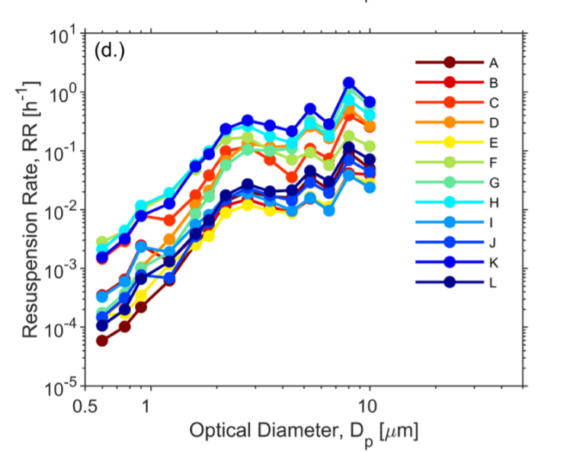
Resuspension model
Variation of resuspension rate with diameter
I plotted resuspension rates along with experimental data from 0.1 to 20um which should cover floor dust’s size range to see if one of the models can be used. The ‘Force model’ using the same coefficients from previous seems to do a good job of explaining resuspension rates from carpets that range from ~10⁻⁴ to ~10⁻¹ hr ⁻¹ in this size range on a log-log scale.
Log-log scale
Box
Force
Khare&Marr (linear)
Mean size-resolved resuspension rates (RR, h−1 ) for each carpet (A−L) (Wu et. al 2021)

Slide 14
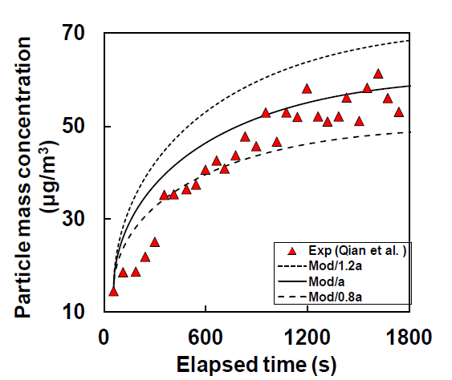
Resuspension model
You, Siming, and Man Pun Wan. "A risk assessment scheme of infection transmission indoors incorporating the impact of resuspension." Risk Analysis 35.8 (2015): 1488-1502.
2) Variation of resuspension rate with time
Using r that changes with t using a power law function (You et al.)
“The calculated resuspension rate generally declined with time due to the depletion of resuspendable particles on the flooring samples and can be fitted by the power law as
𝑅(𝑡) = 𝑎r*𝑡^−𝑏r . (4.6)
The values of 𝑎r and 𝑏r for various cases are listed in Table 4.1. The resuspension rate, 𝑅(𝑡) depends on the surface particle concentration and particle resuspension area. Hence, 𝑅(𝑡) is divided by the initial surface particle concentration, M(0), and resuspension area, 𝑆r, to give the normalized resuspension rate:
Λ(𝑡) = 𝑅(𝑡)/[𝑀(0)𝑆r]. (4.7)”

Slide 15
You, Siming, and Man Pun Wan. "A risk assessment scheme of infection transmission indoors incorporating the impact of resuspension." Risk Analysis 35.8 (2015): 1488-1502.
Resuspension model
2) Variation of resuspension rate with time
Constant averaged resuspension rate from Qian et. al
Using r that changes with t using a power law function (You et al.)

Slide 16
Resuspension model
Including vacuuming

